Slide 1
Bracketing Methods

Slide 2
Bisection Method

Slide 3

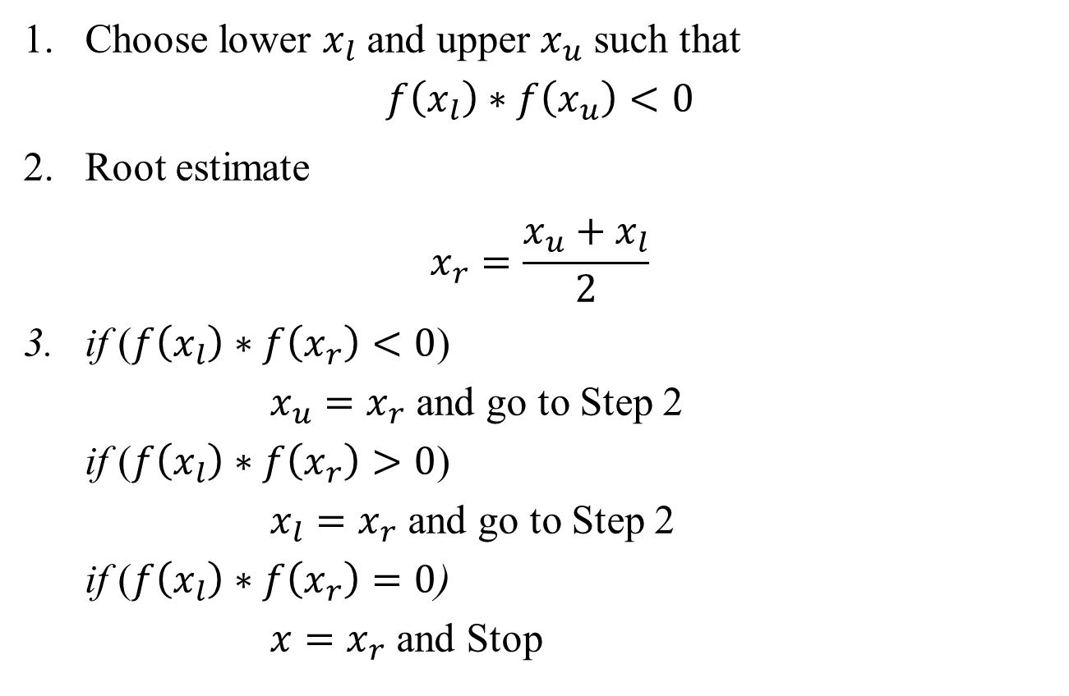

Slide 4

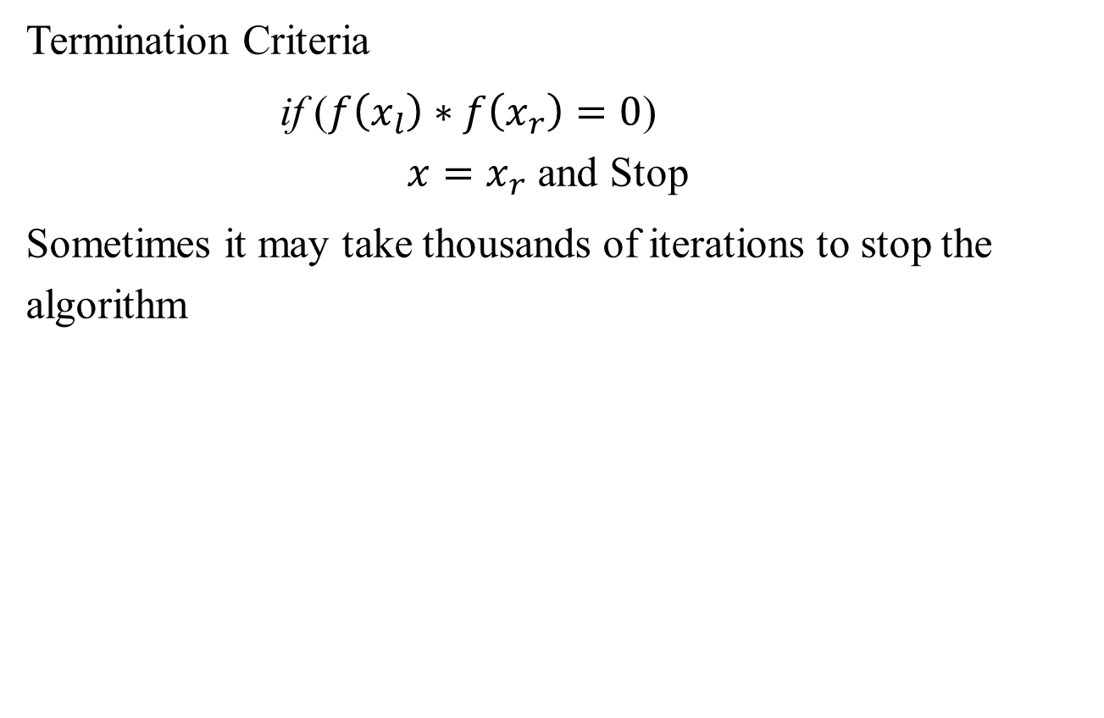

Slide 5
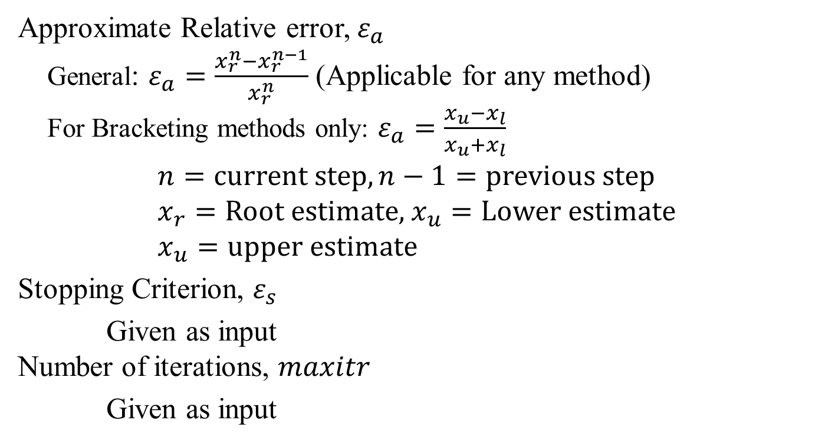
Setting Termination Criteria: Terminologies

Slide 6



Slide 7

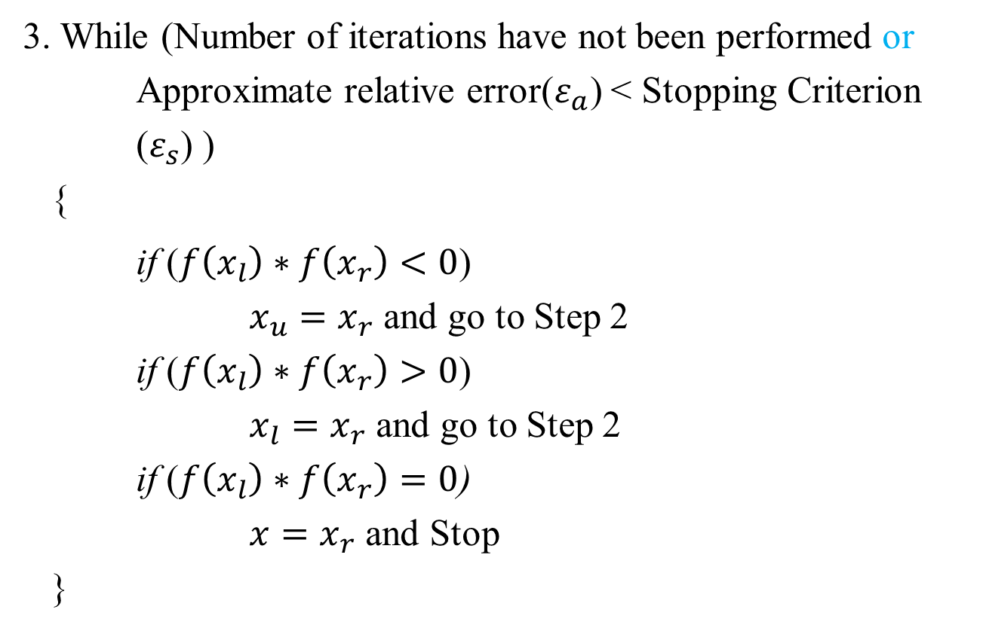

Slide 8
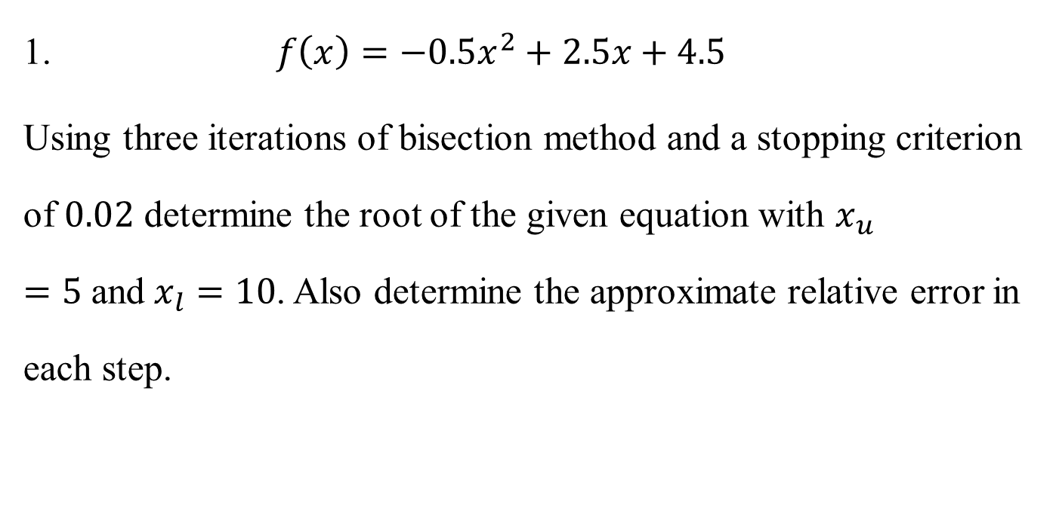
Bisection Method: Mathematical Problem

Slide 9
False Position Method

Slide 10



Slide 11


Slide 12
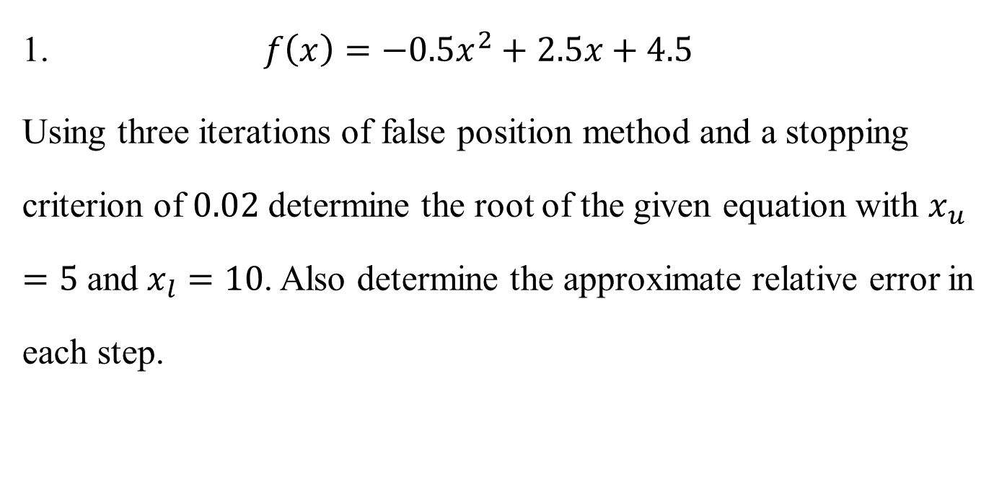
False Position Method: Mathematical Problem

